Slide 1
Exercise 1
Design an abstract super class named Shape that has the following
Attributes
String color (default value = white), bool filled(default value = false)
Constructors
Constructor that takes in the String color and the filled
Methods,
Abstract method called getArea() and getPerimeter() and both of them return double
Create a Rectangle class that inherits from this class and has the following
Attributes
Double height (default value = 1.0), Double width (default value = 1.0)
Constructor for setting the width and the height
Implement both the getArea and getPerimeter methods

Slide 2
Exercise 1 Continue
Create a Cirlce class that inherits from this class and has the following
Attributes
Double radius (default value = 1.0)
Implement both getArea() and getPerimeter()

Slide 3
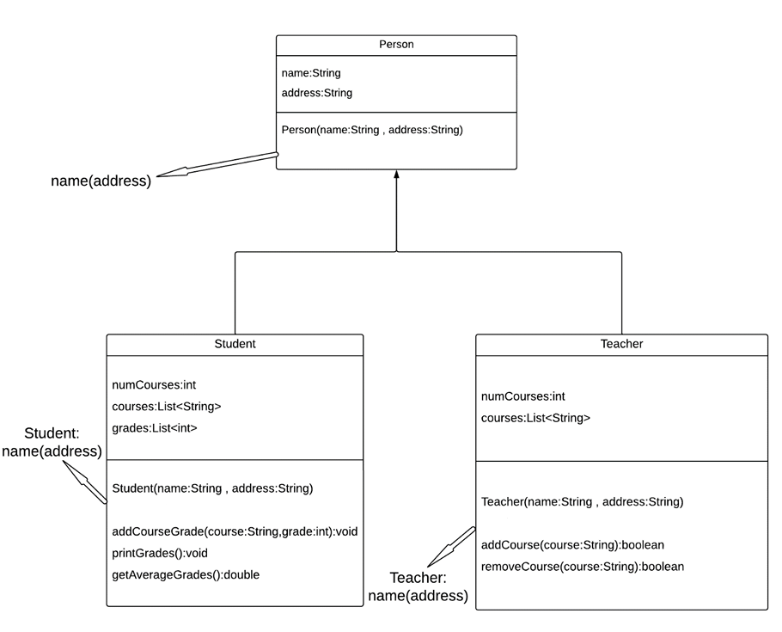
Exercise 2 Continue

Slide 4
Exercise 2 Continue
Following the previous diagram, create the parent and child classes
In the Teacher class method addCourse returns false if a course already exists
In the Teacher class method removeCourse returns false if a course doesn’t exist

